Slide 1
Game Systems
Input
Game Shell
Network
Output
Visualisation
AI
World
Sound
UI
Look Up
Rules
Physics

Slide 2
Message System
A message system provides a common language with which multiple systems can communicate to the world model (and optionally other systems)
Input
Network
AI
Messages
World
UI
The world model does not need to know where the message originates

Slide 3
Message System
Another view:
Network
AI
UI
??
Message Queue Exposed Message System
A bit like a network system…
World

Slide 4
Hierarchical Model
Hierarchical model
Builds an OO structure of world entities inheriting functionality
A logical way of modelling the world
Some problems though
Functionality tends to drift to the top (into the base) meaning every entity, however simple, can carry around a lot of useless data and functionality
If we keep it at the bottom we have problems re-using functionality between entities
My experience
Used in Dune and it did work but became a bit tangled and hence tricky to debug in the beta phase

Slide 5
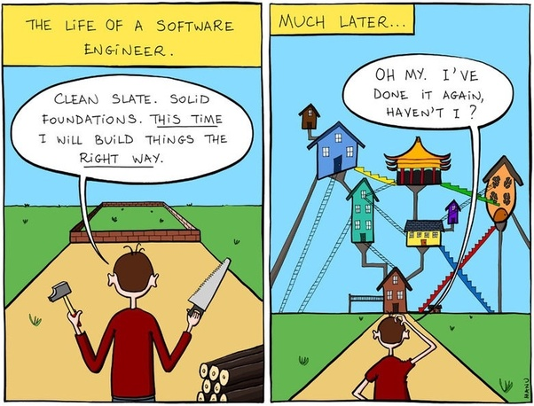

Slide 6
Component Based
Rather than use a hierarchy we create a game entity from an aggregation of components
Each component implements some functionality
Components should be independent of each other*
A game entity is made by adding required components
Unity uses this structure
Example components
Movement
Render
Run script
Physics etc.

Slide 7
Component Based
Fits the ‘prefer composition to inheritance’ rule and game requirements of shallow hierarchies
You could store a collection of pointers to components in an entity
Further extension of this could actually remove the entity wrapper completely
See figure 2: http://cowboyprogramming.com/2007/01/05/evolve-your-heirachy/ (next slide)
Data driven capabilities now exist by adding components based on data written by the designers

Slide 8
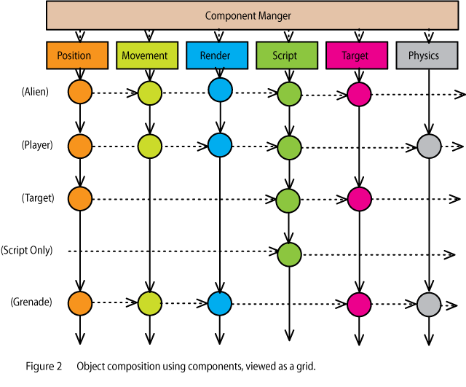
Object as pure aggregation
From: http://cowboyprogramming.com/2007/01/05/evolve-your-heirachy/

Slide 9
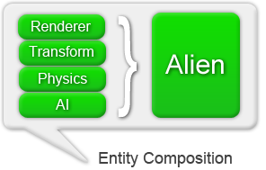
Component Based
In practice we could have a component manager that manages the components
We could also have an interface class to define a component with at least
An Update function
For a practical example see the, rather old but still relevant, Elephant game framework: http://elephant.codeplex.com/

Slide 10
Component Based
Positives
Removes hierarchical problems
Allows more data driven games
More efficient and often faster
Problems
In practice components do often need to know about each other. To communicate they could go via a component manager or directly via pointers
Order of components is important across entities e.g. Each should update physics before animation etc.

Slide 11
End

Slide 12
Object Oriented Design Problems
Threading issues due to keeping state within object
Requires synchronisation
Virtual functions causing late binding
Poor memory access patterns
E.g. see: https://macton.smugmug.com/Other/2008-07-15-by-Eye-Fi/n-xmKDH/i-BrHWXdJ
Data-Oriented Design
Works by constructing code around the data
Work on blocks of data improves cache coherency and allows for parallelization and vectorization
See: http://gamedevelopment.tutsplus.com/articles/what-is-data-oriented-game-engine-design--cms-21052

Slide 13
Further Reading
Game Engine Architecture, Second Edition, Jason Gregory, 2014, ISBN: 978-1466560017
The best book for engine construction
Game Programming Patterns, 2014, R. Nystrom, ISBN: 978-0990582908
Solutions to common game design issues
Game Coding Complete, Fourth Edition, Mike McShaffry, 2012, Delmar, ISBN:978-1133776574.
A general all rounder for games programmers

